Slide 1
Lecture 13

Slide 2
Question 223.15.1
Consider the prism to your right. If we illuminate it with white light, which color will be at the top of the rainbow?
Red
Yellow
Green
Blue
Violet
δ

Slide 3
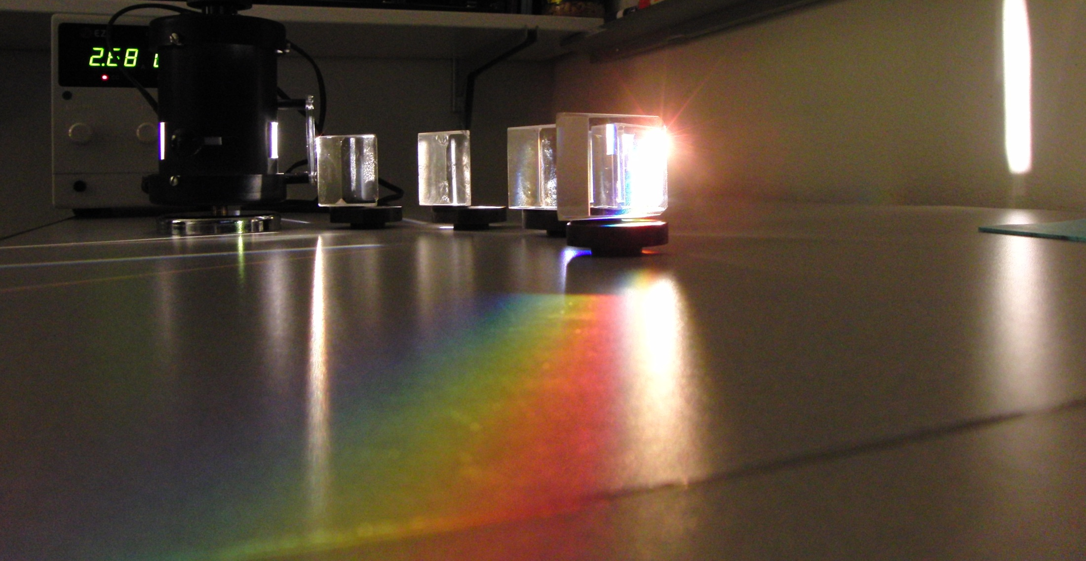

Slide 5
δ_{R}
White Light
δ_{B}
Red
Blue

Slide 6
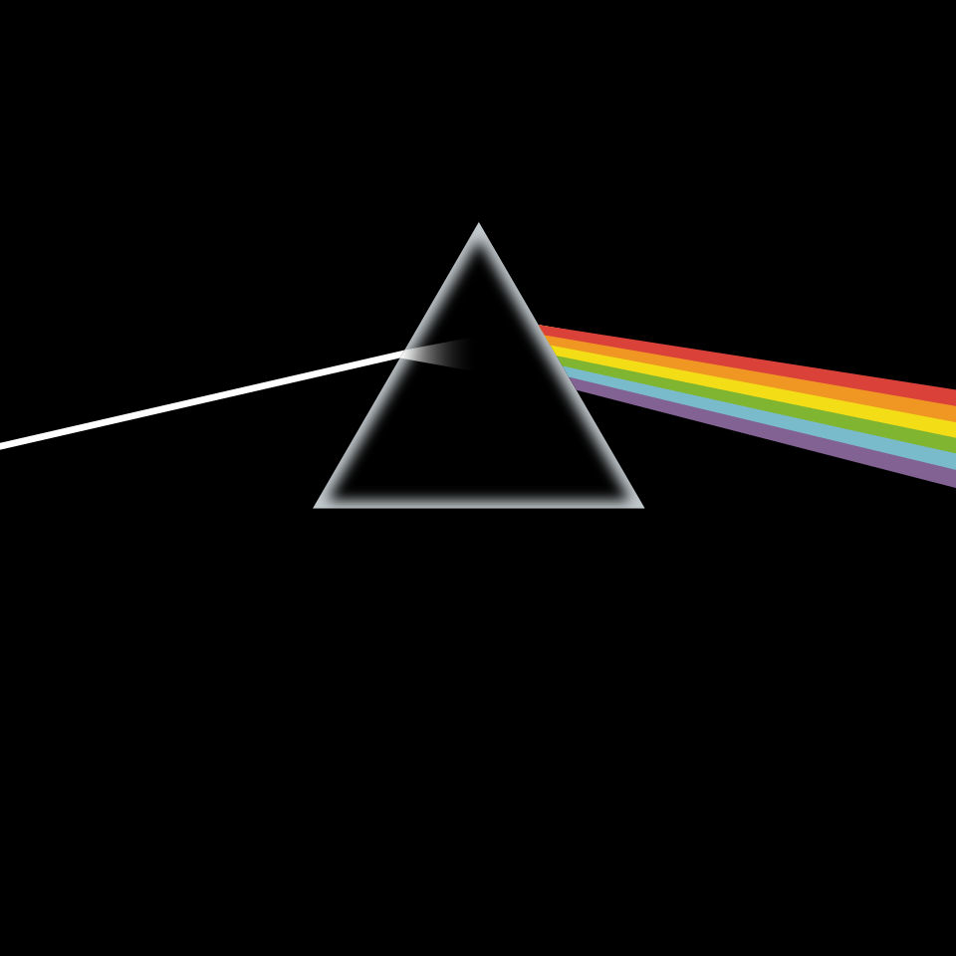
Question
A famous 80’s band used a prism and dispersion on one of their album covers. The cover is an artist’s conception, not an actual photograph of the physics. Did the album cover artist get the drawing right?
Yes
No
Partially right (be prepared to say what is wrong if you choose this option)

Slide 7
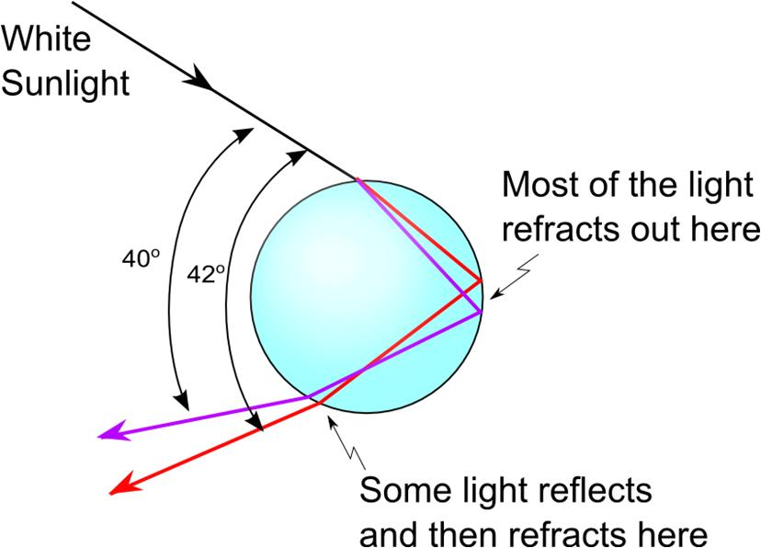

Slide 8
Finding δ
Φ/2
δ
η
φ
φ
φ
β
θ₁
α
α
θ₁
θ₂
θ₂
n

Slide 9
Question 223.15.2
You build a prism out of a thin walled container filled with water. If the water prism is immersed in a tank of water, does it still make a rainbow?
Yes
No
Can’t tell

Slide 10
Question 223.15.3
You are building a camera with refractive lenses. Would you expect all colors of light to focus at the same point?
Yes
No
Can’t tell

Slide 12
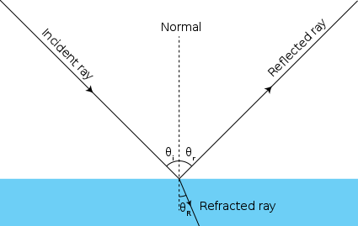

Slide 13
Incoming Plane Wave
Scatterers
Spherical scattered wave forming

Slide 18
Reflected Plane Waves

Slide 19
Steered Radar Beam
RF Emitters with phase delays

Slide 20
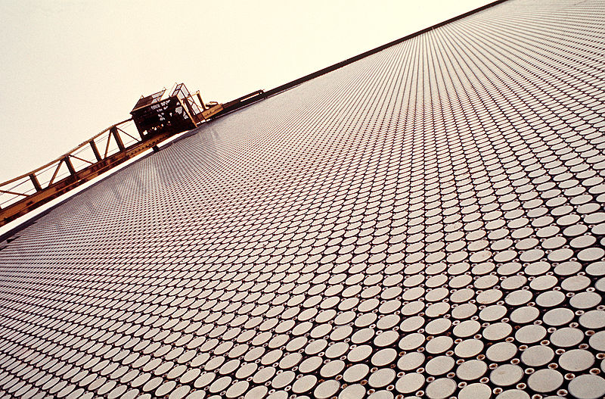
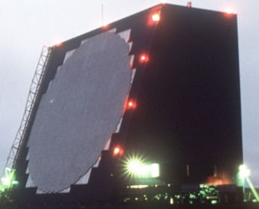
Cobra Dane Radar

Slide 24
Question 223.14.1
To the left is a photo of several light beams. Is the light traveling
from the right to the left
From the left to the right
Can’t tell

Slide 25
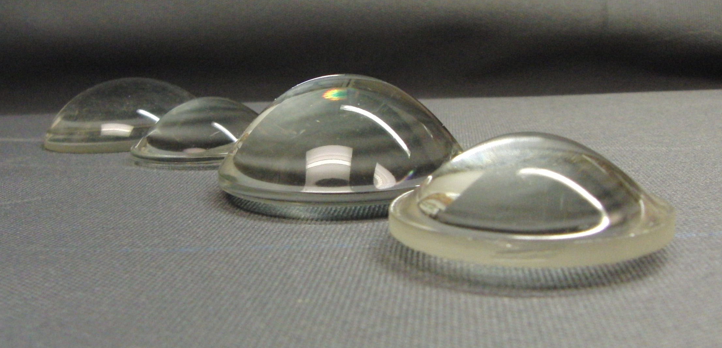

Slide 26
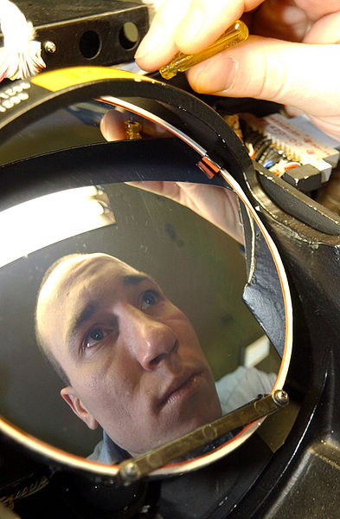

Slide 27
Question 233.14.2
Suppose we have a material with an index of refraction of 2. What is the speed of the light in this material?
c/2
c/4
2c
4c
Can’t tell

Slide 28
Question 223.14.3
Light passes from a material with index of refraction 1.3 into one with index of refraction 1.2. Compared to the incident ray, the refracted ray
bends toward the normal
is undeflected
bends away from the normal

Slide 29
Incident Ray
Reflected Ray
θ₁
θ₃
Air
Fast
n₁ (Small)
Glass
Slow
n₂ (Large)
θ₂
Transmitted Ray

Slide 30
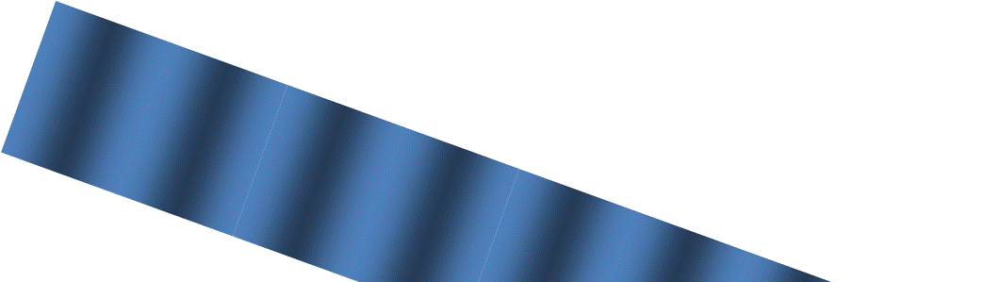

B
θ_{i}
θ_{i}
D
A
θ_{t}
θ_{t}
C

Slide 31
Chlorophyll Spectrum (Public Domain image courtesy Kurzon)

Slide 32
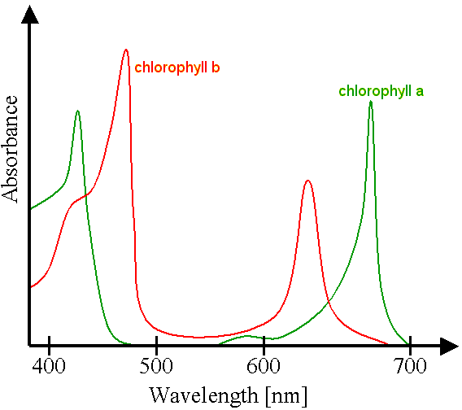

Slide 33
END

Slide 34
Question 223.13.4
I have a ray of light traveling from left to right across the room near the front. Can you see the ray?
No
Yes
I can see only part of the ray

Slide 35
Question 223.13.5
A laser beam is incident on a glass sheet. There is no apparent reflected ray. We might conclude that…
The glass has a high index of refraction
The glass surface is rough
The glass has a low index of refraction
The glass is opaque

Slide 36
Wave Crests
Rays

Slide 37
Question 9.1
A specular reflector is ……..
A reflector that is spectacular!
One that can cook a hot dog
Like a mirror
A rough surface

Slide 38
Rays

Slide 40
Question 35.3.6
I have a neat demo on the board where light goes from left to right. You can see the path the light takes. How can this be?
The light ray is a different color than the laser, so I can see it.
The light ray must follow the law of reflection, so it must be bouncing back along it’s original path
The light ray must be hitting dust in the air as it travels, so we see the scattered light from the dust.
The light is not a single ray, and part of the light beam it hits the board, sending rays to my eyes

Slide 41
θ_{i}
θ_{r}

Slide 42
Question 9.2
A diffuse reflector is ……..
A reflector that is spectacular!
One that can cook a hot dog
Like a mirror
A rough surface

Slide 43
Question 223.13.6
Are most natural surfaces diffuse or specular reflectors?
Diffuse
Specular

Slide 44
Question 223.13.7
An observer at point O is facing a mirror and observes a light source S. Where does the observer perceive the mirror image of the source to be located?
mirror
O
3
1
S
2
4

Slide 45
Question 223.13.8
In the movies, you sometimes see an actor looking in a mirror and you can see his face in the mirror. During the filming of this scene, what does the actor see in the mirror?
his face
your face
the director’s face
the movie camera
impossible to determine

Slide 46
Question 223.13.9
When watching the Moon over the ocean, you often see a long streak of light on the surface of the water. This occurs because:
the Moon is very large
atmospheric conditions are just right
the ocean is calm
the ocean is wavy
motion of the Moon
G

Slide 47
Law of Reflection, cont.
The angle of reflection is equal to the angle of incidence
θ₁’= θ₁
This relationship is called the Law of Reflection
The incident ray, the reflected ray and the normal are all in the same plane

Slide 48
Retroreflection
Assume the angle between two mirrors is 90º
The reflected beam returns to the source parallel to its original path
This phenomenon is called retroreflection
θ₄
θ₃
θ₁
θ₂
α

Slide 49
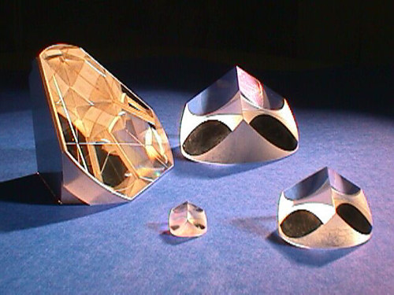
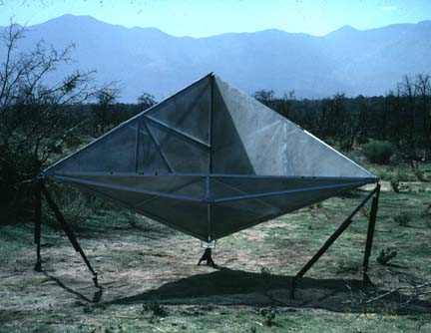
Retroreflectors

Slide 50
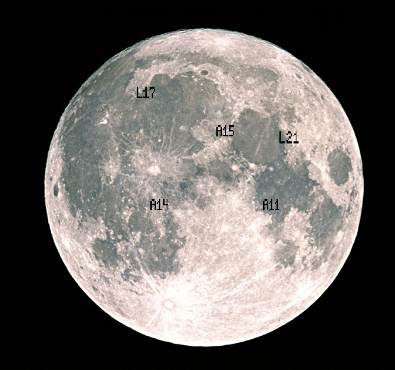
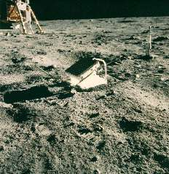
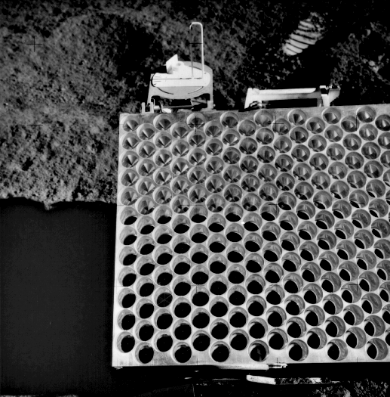
Apollo Retro-reflectors

Slide 51
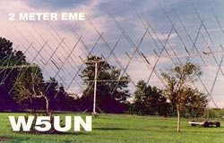
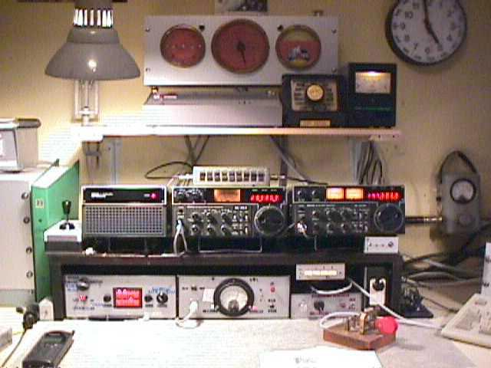
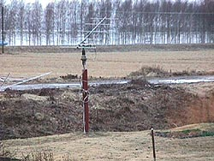
Try it at Home
Amateur Radio Moonbounce Communication
http://www.arrl.org/news/features/2002/01/21/1/

Slide 52
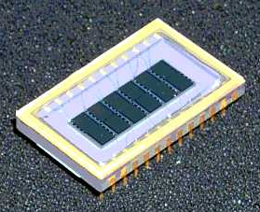
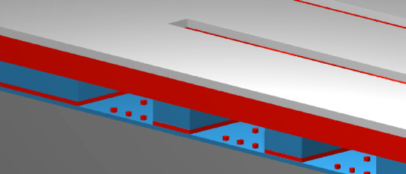
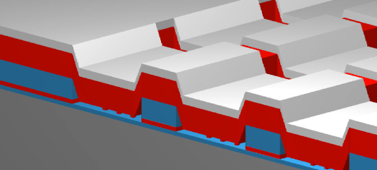
Micro Mirror Arrays
A high-tech example is the new micro-mirror arrays
ITT version
Metal “Mirror”
+-
GEMS Device Off-State
GEMS Device On-State
6 channel GEMS Device
(50 Channel Device is in Development)

Slide 53
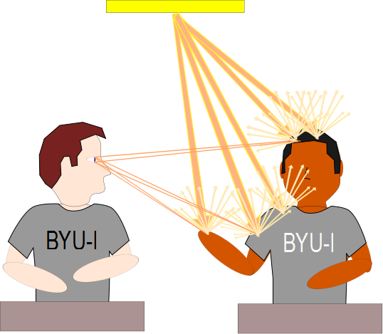

Slide 54
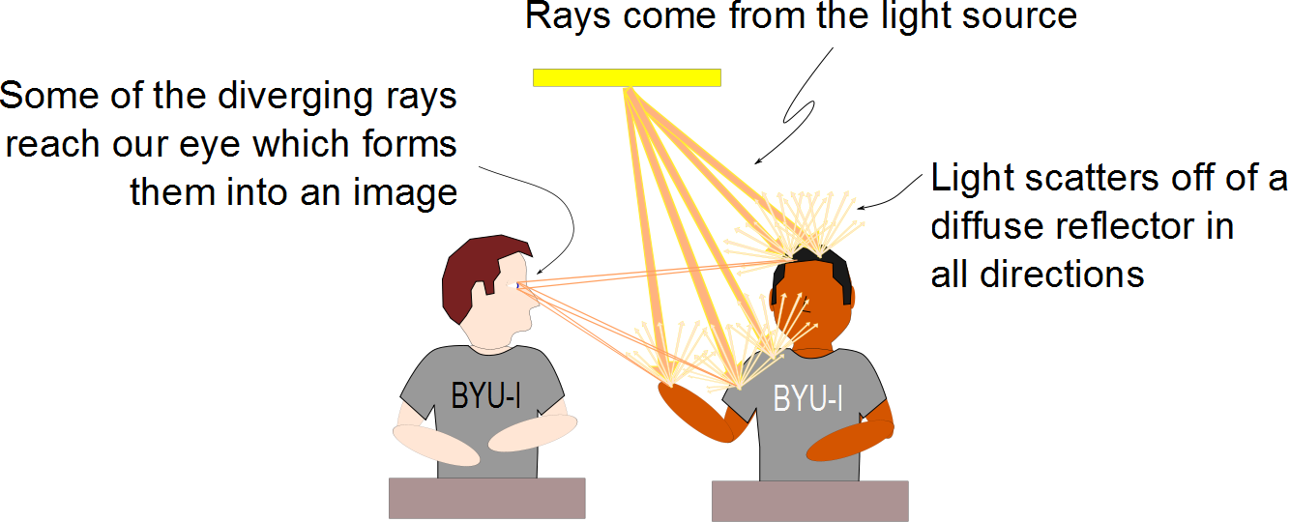

Slide 55
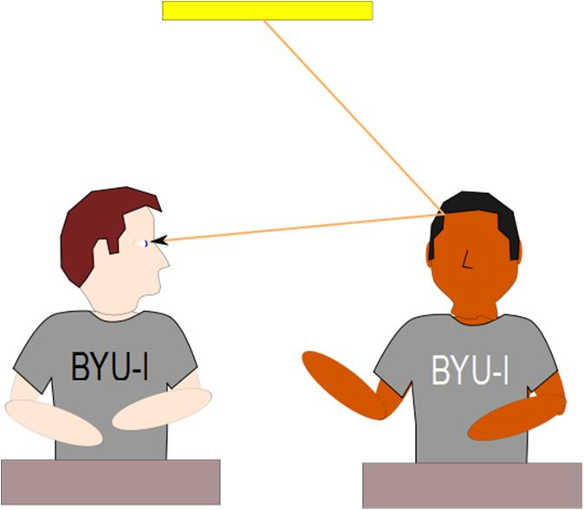
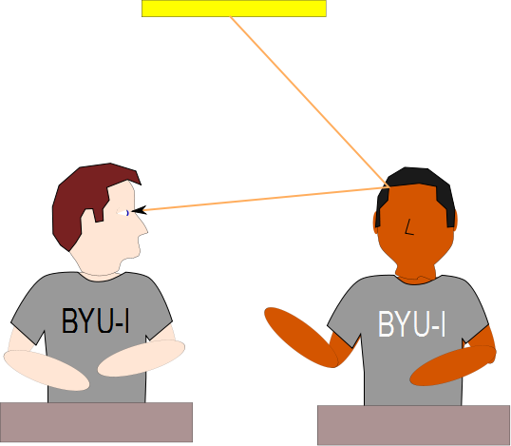

Slide 56
Question 223.13.10
You hold a hand mirror 0.5 m in front of you and look at your reflection in a full-length mirror 1 m behind you. How far in back of the big mirror do you see the image of your face?
0.5 m
1.0 m
1.5 m
2.0 m
2.5 m
G

Slide 57
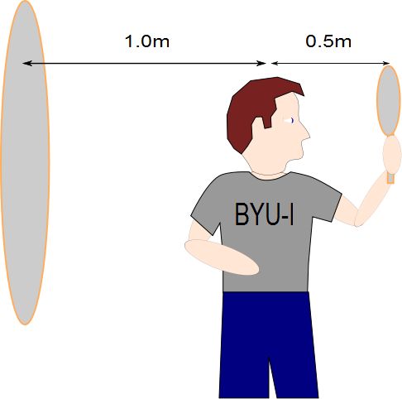
Question 223.13.11
The image of the man’s face in the small mirror will be half a meter away. How far away from the large mirror will the image of this image be?
Half a meter
A meter
1.5 meters
2 meters
What are you talking about?

Slide 58
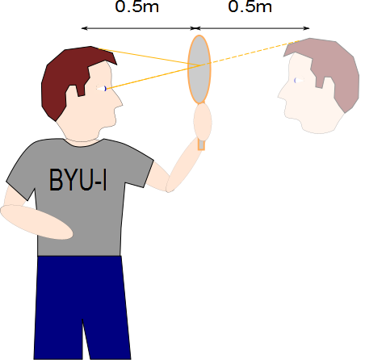

Slide 59
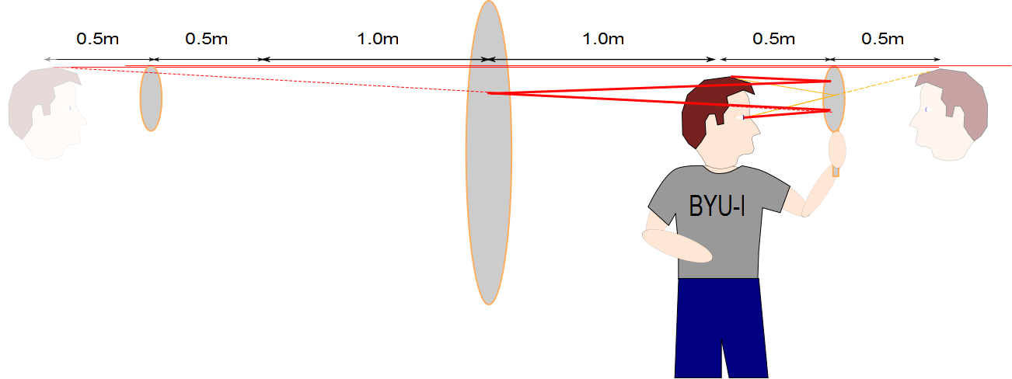

Slide 60
Question 223.14.1
To the left is a photo of several light beams. Is the light traveling
from the right to the left
From the left to the right
Can’t tell

Slide 61
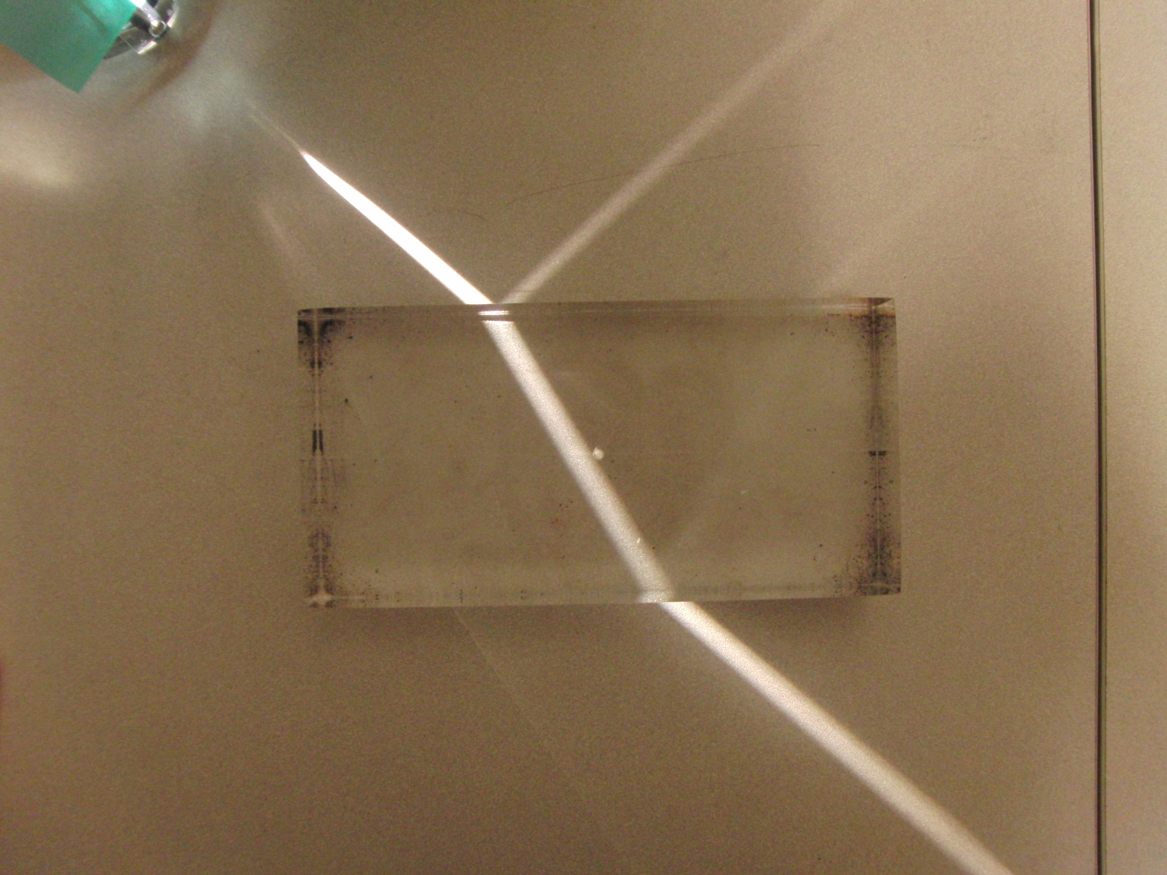

Slide 64
Question 223.14.1.5
We have found that when a wave enters a material, its speed may change. But we remember from wave theory v=λf But it is time to review: does λ change, or does f change? Wavelength
Frequency
Both
Can’t tell

Slide 65
Question 233.14.2
Suppose we have a material with an index of refraction of 2. What is the speed of the light in this material?
c/2
c/4
2c
4c
Can’t tell

Slide 66
Incident Ray
Reflected Ray
θ₁
θ₃
Air
Fast
n₁ (Small)
Glass
Slow
n₂ (Large)
θ₂
Transmitted Ray

Slide 68
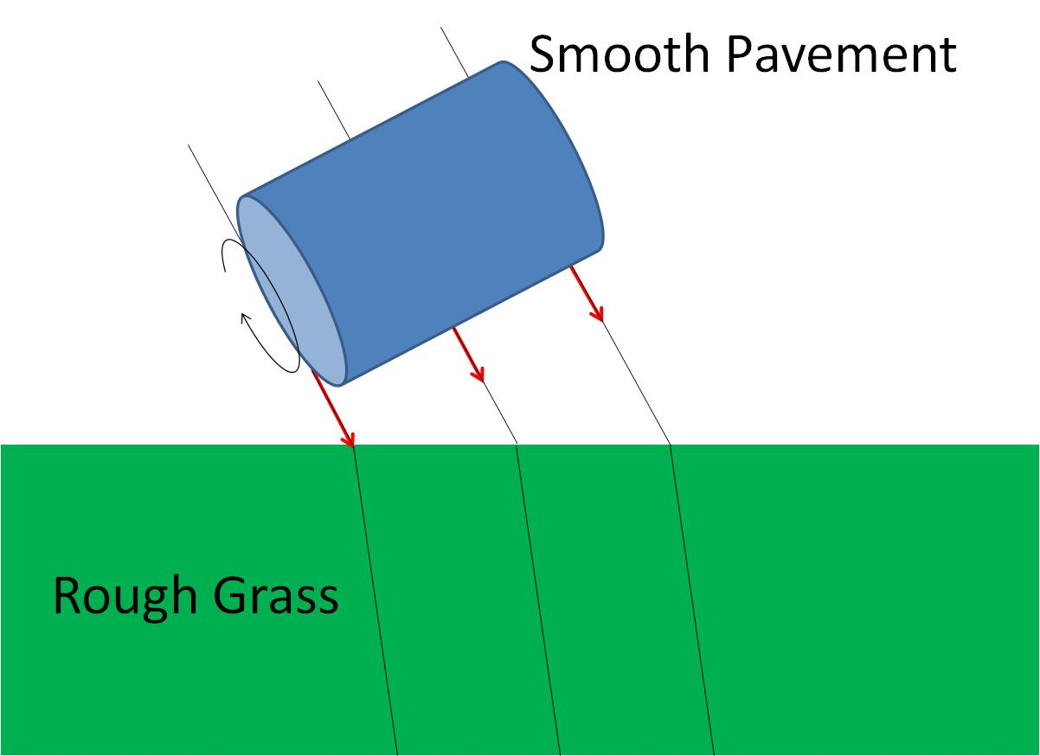
Smooth Pavement
Rough Grass

Slide 69
Smooth Pavement
Rough Grass

Slide 70
Smooth Pavement
Rough Grass

Slide 71
θ_{i}
θ_{t}

Slide 72
θ
φ

Slide 73
Question 223.14.3
Light passes from a material with index of refraction 1.3 into one with index of refraction 1.2. Compared to the incident ray, the refracted ray
bends toward the normal
is undeflected
bends away from the normal

Slide 74
Question 223.14.5.5
The index of refraction of the Lucite block is 1.4. The angle θ_{i} = 20°. What is θ_{t}?
14. 14 °
0. 247 °
0.499 °
28. 61 °
θ_{i}
θ_{t}

Slide 75
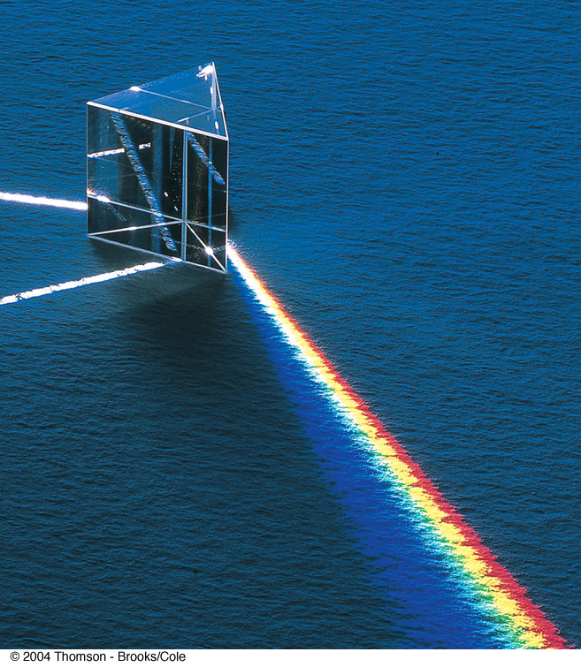
Question 223.14.6
In the picture to the right, there is a input white light ray, and a dispersed set of rays. There is another white ray. Why might that be?
It took two rays of white light to make the rainbow bright enough.
It is an optical illusion, it is not really there
It is due to internal reflection
It is the refracted ray leaving the prism.

Slide 76
Transmitted Ray
θ₂
Air
Fast
n₂ (Small)
Glass
Slow
n₁ (Large)
θ₁
θ₃
Incident Ray
Reflected Ray

Slide 77
Question 223.14.5
As light from the Sun enters the atmosphere, it refracts due to the small difference between the speeds of light in air and in vacuum. The optical length of the day is defined as the time interval between the instant when the top of the Sun is just visibly observed above the horizon to the instant at which the top of the Sun just disappears below the horizon. The geometric length of the day is defined as the time interval between the instant when a geometric straight line drawn from the observer to the top of the Sun just clears the horizon to the instant at which this line just dips below the horizon. Which is longer?
the optical length of a day
the geometric length of a day

Slide 78
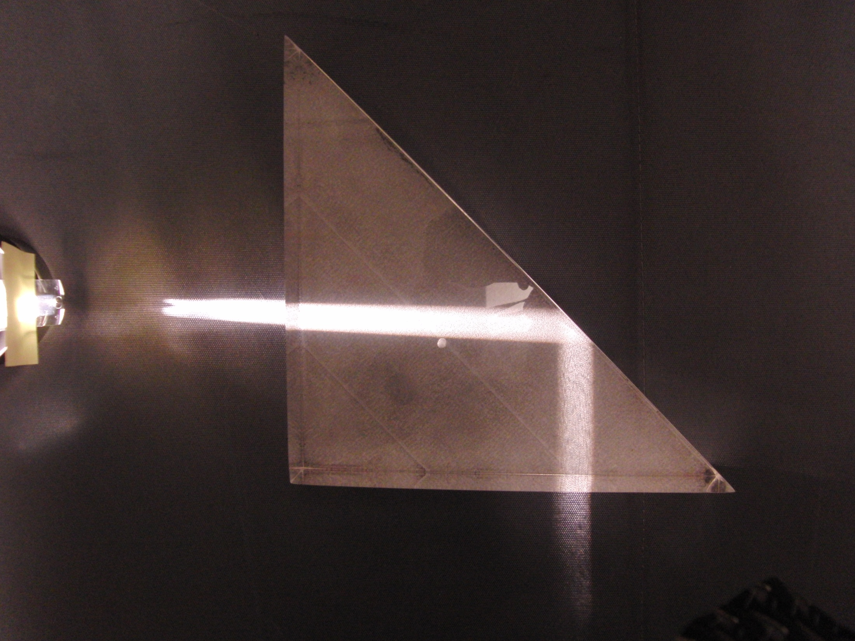

Slide 79
Fast
n₂ (Small)
Slow
n₁ (Large)
θ_{c}
Source

Slide 80
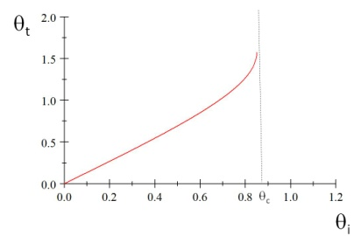
θ_{t}
θ_{c}
θ_{i}

Slide 81
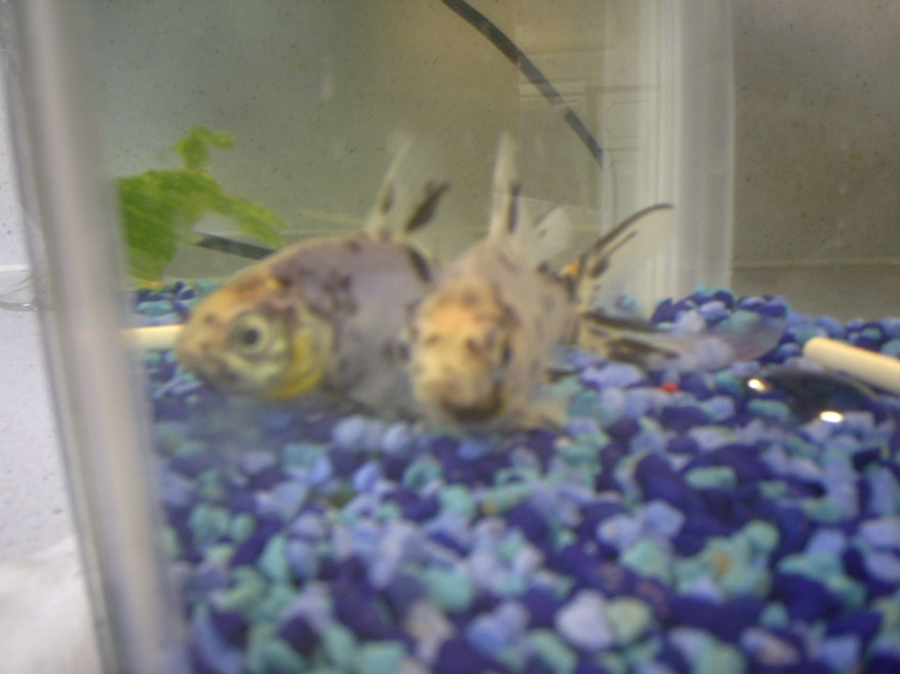

Slide 82
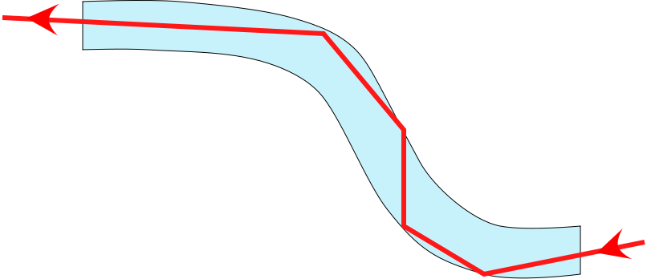
Fiber Optics
An application of internal reflection
Plastic or glass rods are used to “pipe” light from one place to another
Applications include:
medical use of fiber optic cables for diagnosis and correction of medical problems
Telecommunications

Slide 83
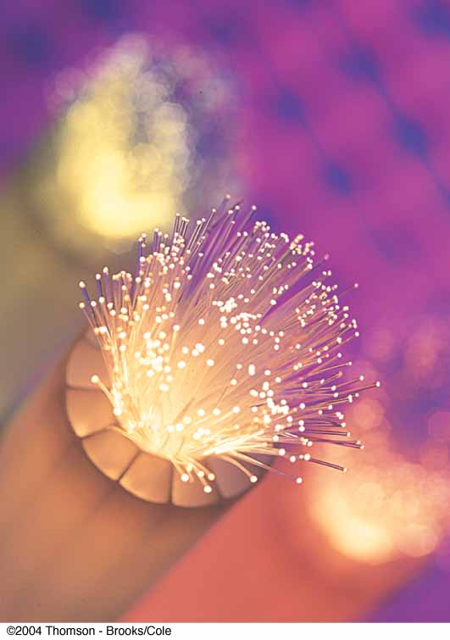
Fiber Optics, cont.
A flexible light pipe is called an optical fiber
A bundle of parallel fibers (shown) can be used to construct an optical transmission line

Slide 84
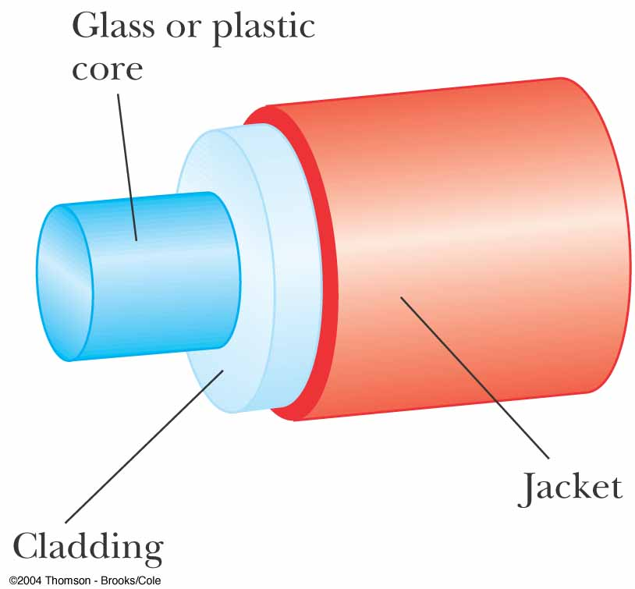
Construction of an Optical Fiber
The transparent core is surrounded by cladding
The cladding has a lower n than the core
This allows the light in the core to experience total internal reflection
The combination is surrounded by the jacket

Slide 85
Question 223.14.7
You are on a boat, and you are watching a night diving expedition. The divers carry powerful flashlights. To you, the flashlights seem to be a dispersed set of small lights. Why?
The light must come from many flashlights to seem to come from more than one spot
The light is sometimes reflected due to total internal reflection and sometimes not because of the surface waves
The light is blocked by fish and other sea life
Can’t even guess

Slide 86
Question 223.14.8
You are fishing and wish to catch a big one. You want to sneak up on the fish. Can the fish see the shore line?
It depends on where the fish is relative to you and the angle you subtend from the horizontal
No, fish cannot see out of the water due to total internal reflection
Fish can see the shore line, but it can see things overhead better.
It depends on what color you are wearing. The water causes dispersion

Slide 87
Question 223.14.9
You are building a complex optical device on an optical bench. You are out of mirrors. Can you use a prism instead?
Yes
No
Maybe

Slide 88
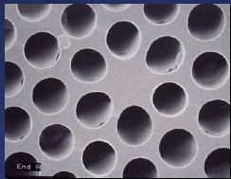
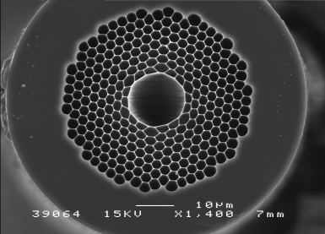
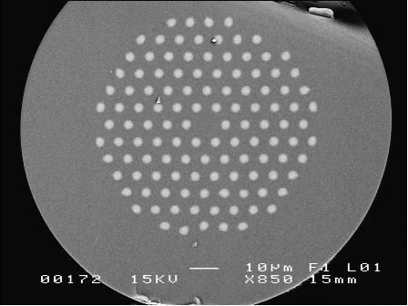
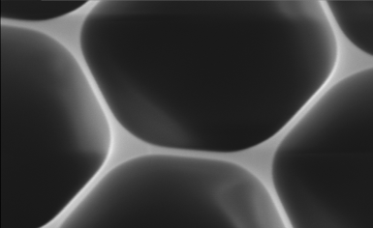
Modern Hollow-Core Fibers
Figure 2. Solid photonic bandgap fibre with isolated high-index cladding rods and a low-index core..
Figure 1. Hollow-core photonic bandgap fibre for guiding 1064nm light (above) and close-up of the bandgap cladding material (below).

Slide 89
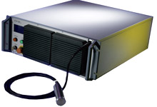
Example: Fiber Lasers
IPT Photonics YLR- LP Series: 10 to 500W Single Mode Linearly Polarized Ytterbium Fiber Lasers
Main Features:
1060 to 1070nm Wavelength Range
Extinction Ratio &gt;20dB
TEMoo (M2&lt;1.1)
Air or Water Cooled Versions
100,000 hours Est. Pump Diode Lifetime
Maintenance Free Operation
Single Mode Fiber Delivery
Applications:
Materials Processing
SHG
Medical
Scientific

